Slide 1
2nd IEEC 2017
Easy Chair
Paper Submission Process

Slide 2
STEP#01:
Go to below mentioned link:
https://easychair.org/conferences/?conf=2ndieec2017

Slide 3
STEP#02:
If you already have an account, go to “login” option
otherwise go to “create an account”

Slide 4
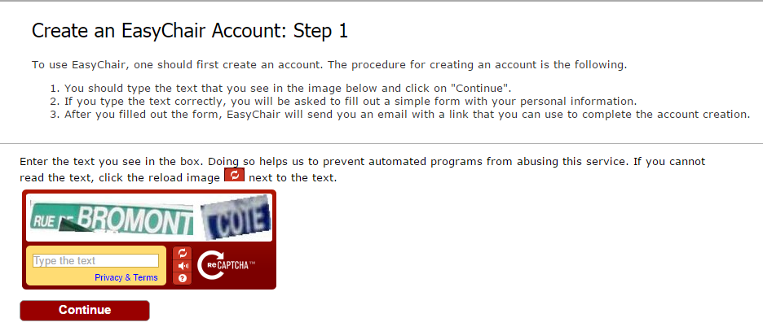
STEP#03:
Enter the text in the box and click continue

Slide 5
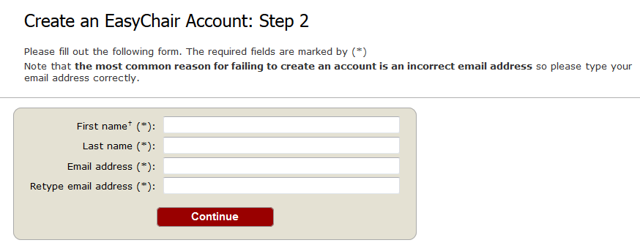
STEP#04:
Enter your details and click continue

Slide 6
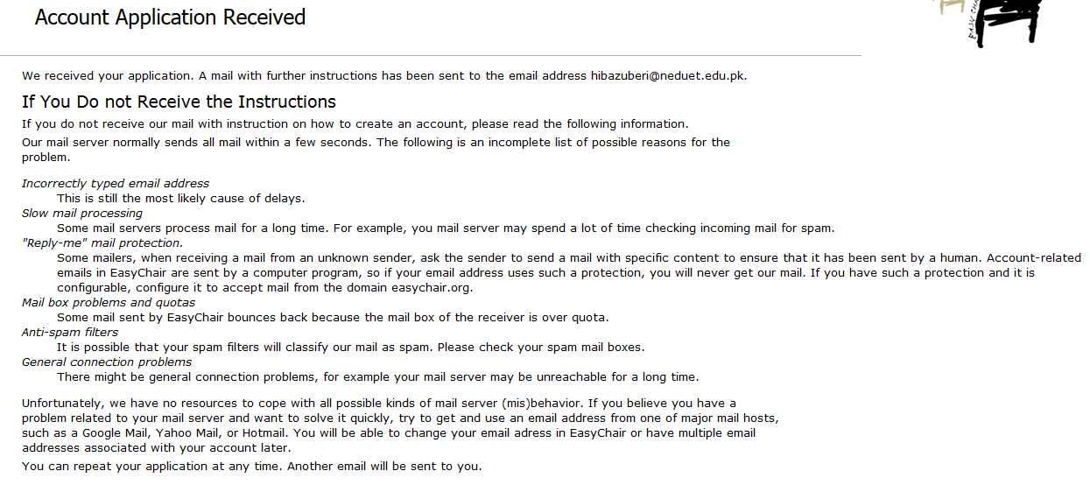
STEP#05:
You will receive account confirmation email on your email address. Click on the link received in the email.
<your email address>

Slide 7
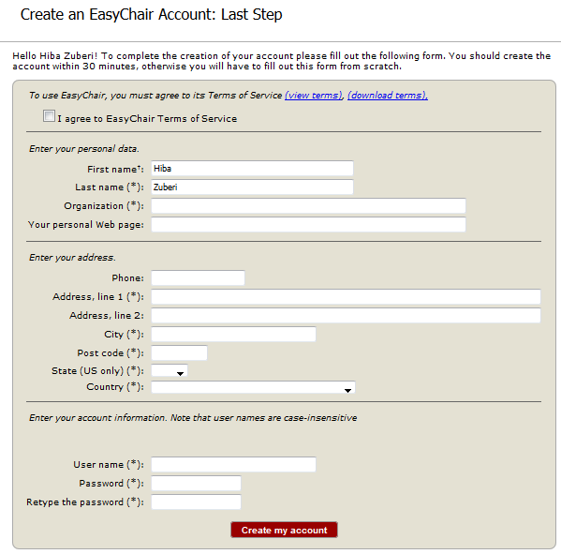
STEP#06:
Enter your details and click “Create my account”

Slide 8
STEP#07:
Your account has been created.

Slide 9
Paper Submission Process

Slide 11
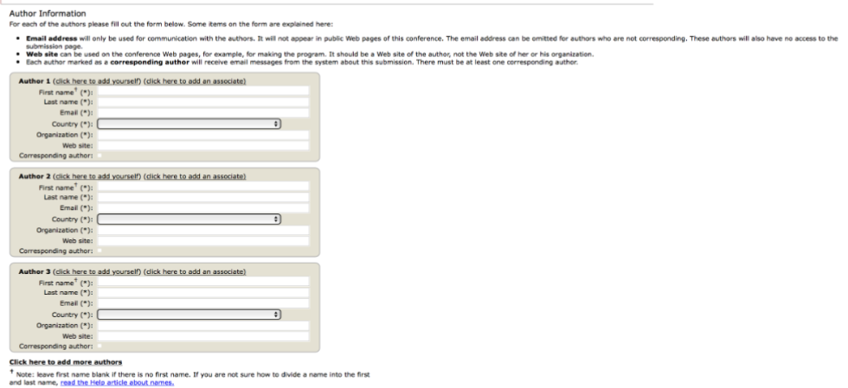
STEP#02:
Fill out all the required information.
You must use the same email address that you signed up with when creating the Easy Chair account.
STEP#03:
Click here if you need to add more authors.

Slide 12
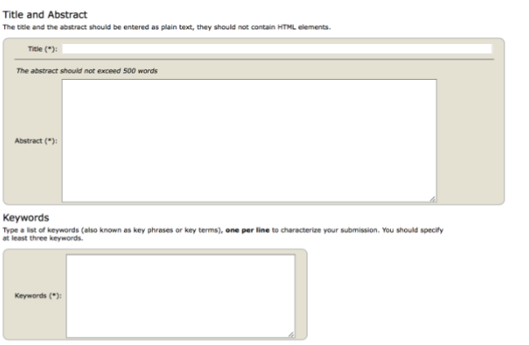
STEP#03
Fill out the title, abstract and keywords

Slide 13
STEP#04:
Upload your paper in pdf format.
Click “Submit” to submit your paper.
NOTE: Uploading may take time so don’t click twice.

Slide 14
STEP#05:
You will receive acknowledgement email for your paper submission.

